Slide 1
GOexpress
Visualise and summarise gene expression data using Gene Ontology
Lightning talk – BioC 2017
Kevin Rue-Albrecht

Slide 2
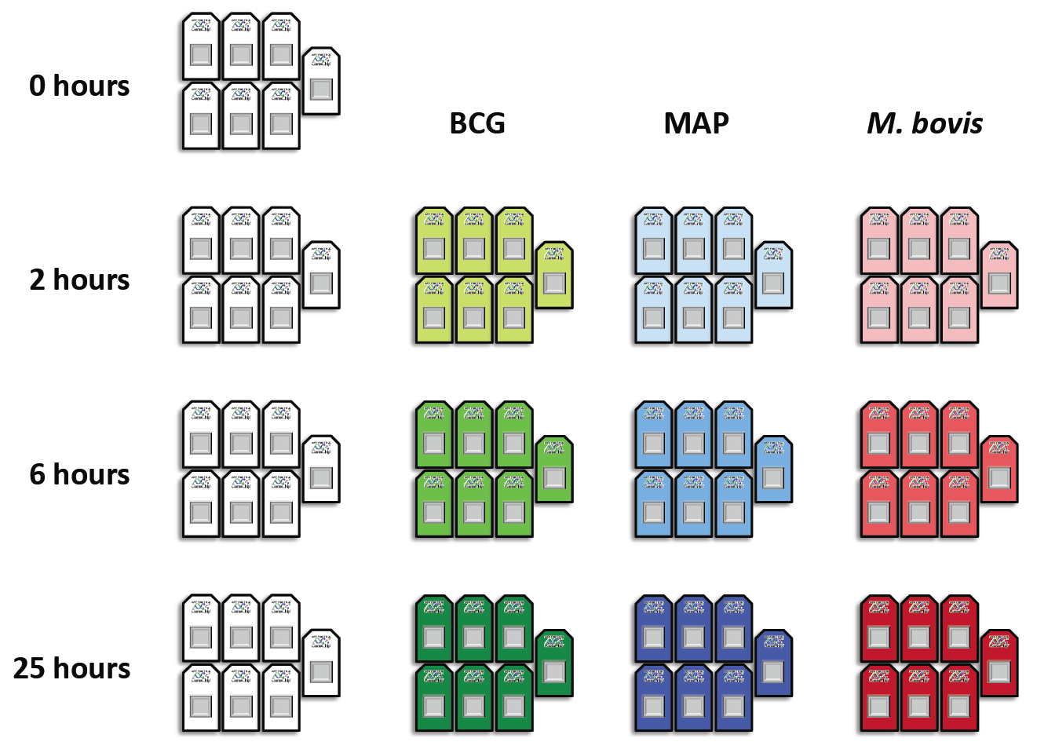
Origins
By-product of PhD work
Transcriptional response of bovine macrophages to tuberculosis infection
Collection of R functions regularly use to visualise gene expression downstream of DE /classification analyses
Affymetrix microarrays, RNA-Seq
Time-series, GO analyses

Slide 3
Challenges
Interoperability
Most ‘interesting’ features/categories to visualise (output of DE and supervised classification analyses)
(GO) annotations: What mappings (feature : category) were used?
Notes:
e.g., goseq : Indirect mapping of Ensembl gene ID through Entrez ID

Slide 4
Workflow

Slide 5
Example plots

Slide 6
Other outputs
Features within a GO category
Ranked table of GO categories

Slide 7
Current approach to: Identification
ANOVA
Maximise gene expression variance between groups / within groups
Caveat: assumptions on the distribution of the data
randomForest
Non-parametric ensemble learning method for classification
Caveat: stochastic output, interpretation of output values, ‘no P-value’
Objective 1: Integrate/support more

Slide 8
Current approach to: Annotations
data.frame of annotations
Column names: c("gene_id", "go_id")
Sources:
Ensembl BioMart: Attempt to automatically detect species from featureNames and fetch all available feature:GO annotations
Manually supplied
Objective 2: Clearly define/store the annotations used during the analysis, to facilitate later visualisation

Slide 9
Present effort: structural update
Introduce S4 methods / classes to replace regular R functions
randomForest(signature = “ExpressionSet”, ...)
oneway.test(signature = “ExpressionSet” , ...)
New multiHtest class
p.adjust(signature = “multiHtest” , ...)
GOrank(signature = “randomForest” , ...)
GOMap class ➔ coercion from AnnDbBimap objects?
ggplot2-friendly downstream methods

Slide 10
Last night’s screenshot

Slide 11
GOMap: an effort to simplify annotation maps

Slide 12
An(other) implementation of the subset method

Slide 13
ggfication of an ExpressionSet

Slide 14
ggfication of an ExpressionSet

Slide 15
Acknowledgements
Paul McGettigan
David Magee
Nicolas Nalpas
Belinda Hernández
Andrew Parnell
Prof. David MacHugh
Prof. Stephen Gordon
UCD OpenSequencing group
UCD PhD Symposium 2014 organising committee
Virtual Institute of Bioinformatics & Evolution (VIBE) meeting 2013
Markus Schröder
Karsten Hokamp
Kate Killick
Simone Coughlan
Carolina Correia
Gael Jalowicki
This presentation has emanated from research conducted with the financial support of Science Foundation Ireland under Grant Number 11/PI/1166.

